Slide 1
Covid-19 Vaccination Data Analysis
Covid-19 vaccination data analysis
Presented By:
Ankita Joshi(21MCI1039)
Divya Puntambekar(21MCI1091)

Slide 2
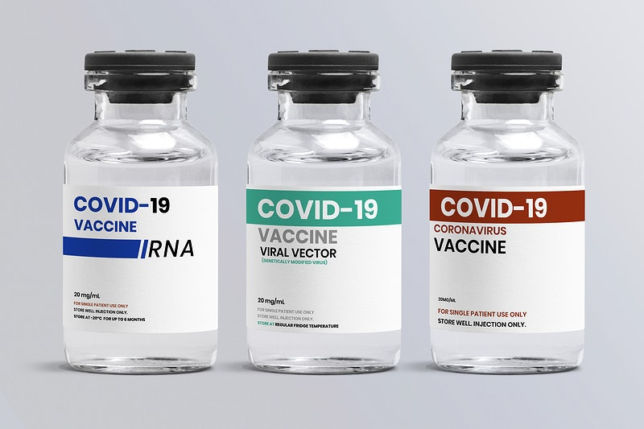
Introduction
A COVID-19 vaccine is a vaccine intended to provide protection against Covid-19, the virus that causes coronavirus disease 2019. Vaccines are credited with reducing the spread of COVID-19 and reducing the severity and death caused by COVID-19. The World Health Organization (WHO) maintains an list of vaccine candidates under evaluation.

Slide 3
Why this data set?
Our vaccination dataset uses the most recent official numbers from governments and health ministries worldwide. This dataset also includes total vaccination, persons vaccinated with 1 dose, total vaccinated person by 100, vaccine used, type of vaccine used, etc. It summarizes vaccination data at the county level.

Slide 4
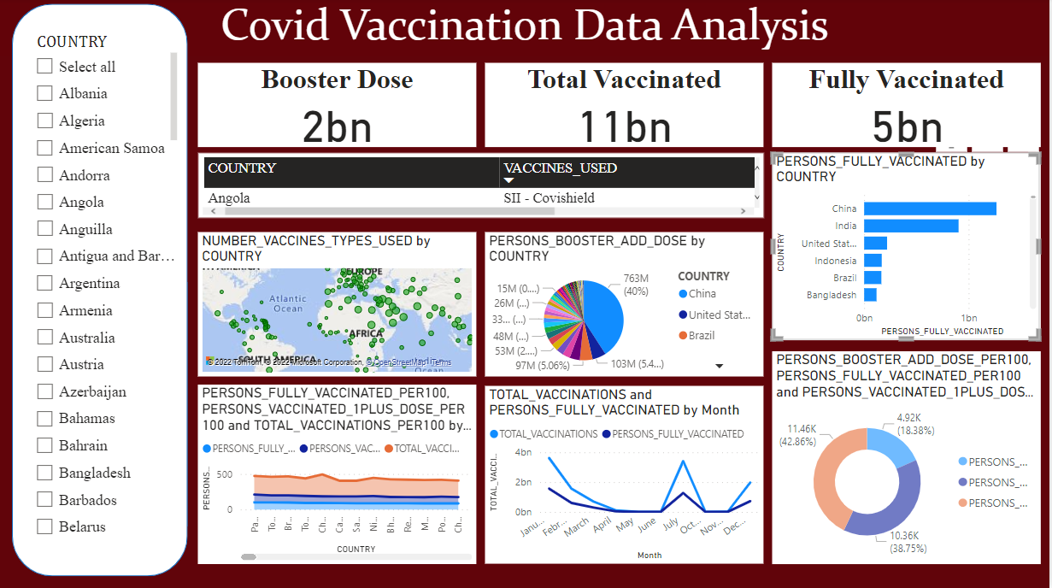
Dashboard
Notes:
https://app.powerbi.com/links/Q2Aq5rx06s?ctid=34bd8bed-2ac1-41ae-9f08-4e0a3f11706c&pbi_source=linkShare

Slide 5
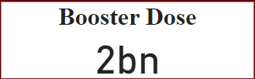
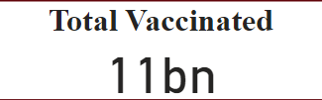

Total No. of population who had their booster dose
Total no. of population had their vaccine as well as booster dose
Total no. population who are fully vaccinated

Slide 6
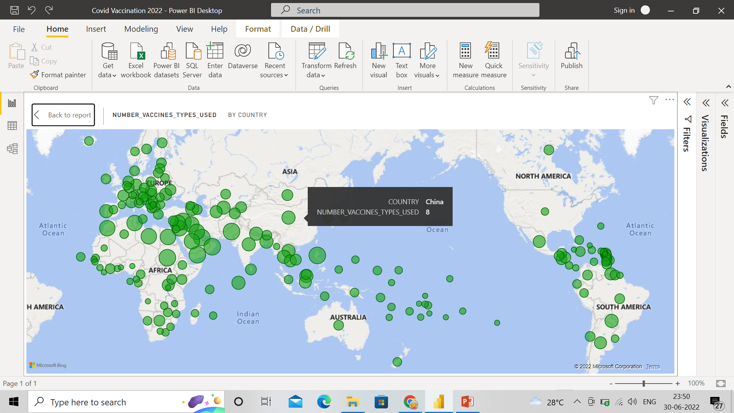
MAP

Slide 7
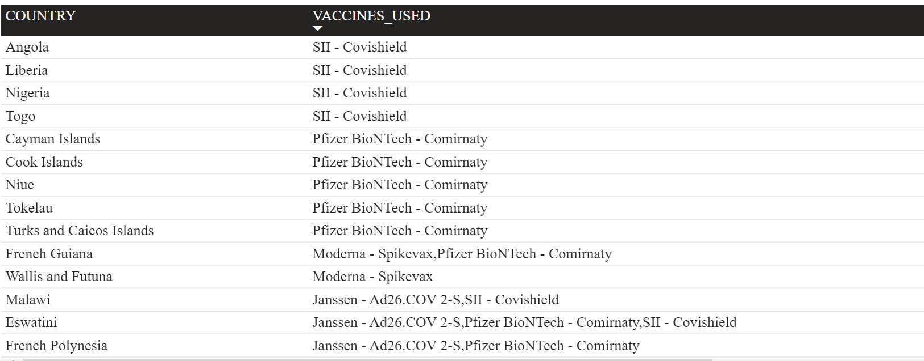
Types of vaccines used worldwide

Slide 8
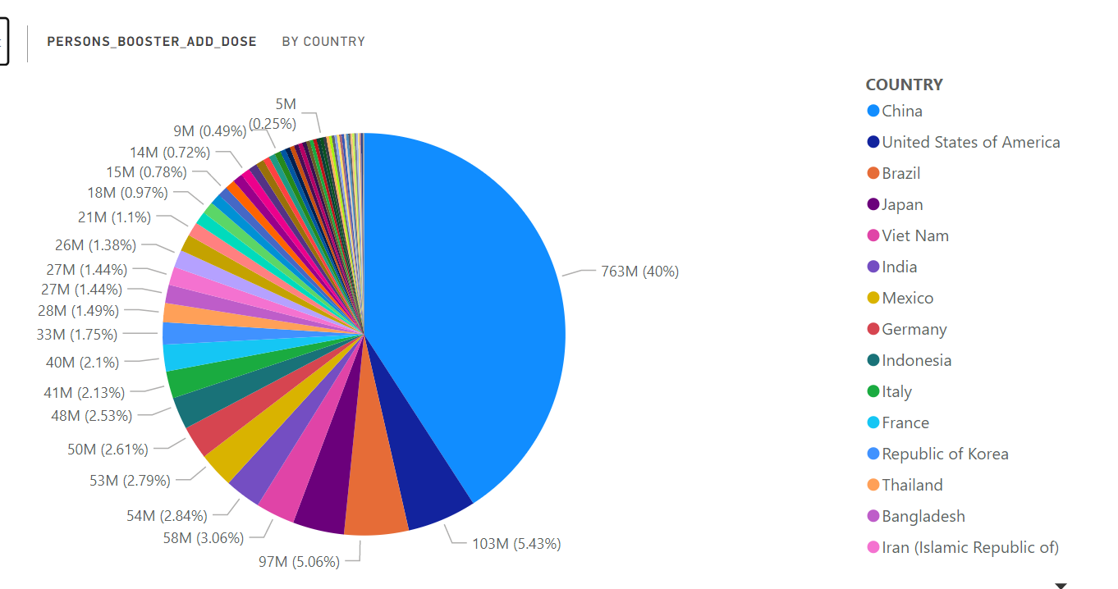
Booster dose worldwide

Slide 9
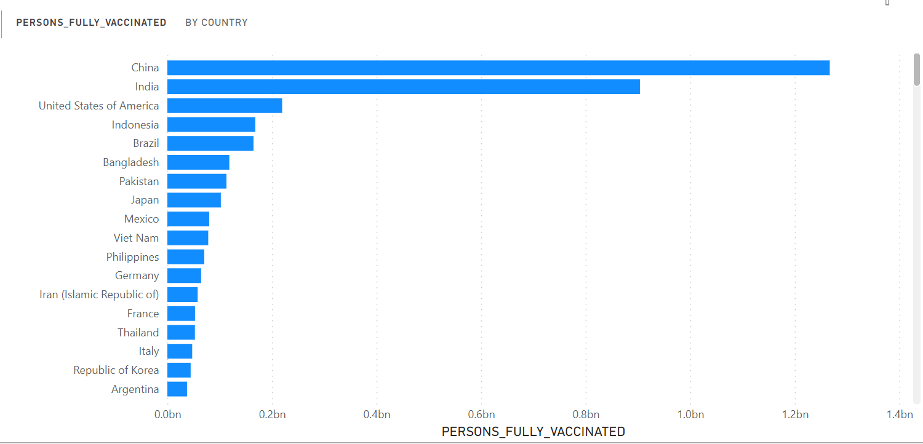
Fully vaccinated Country

Slide 10
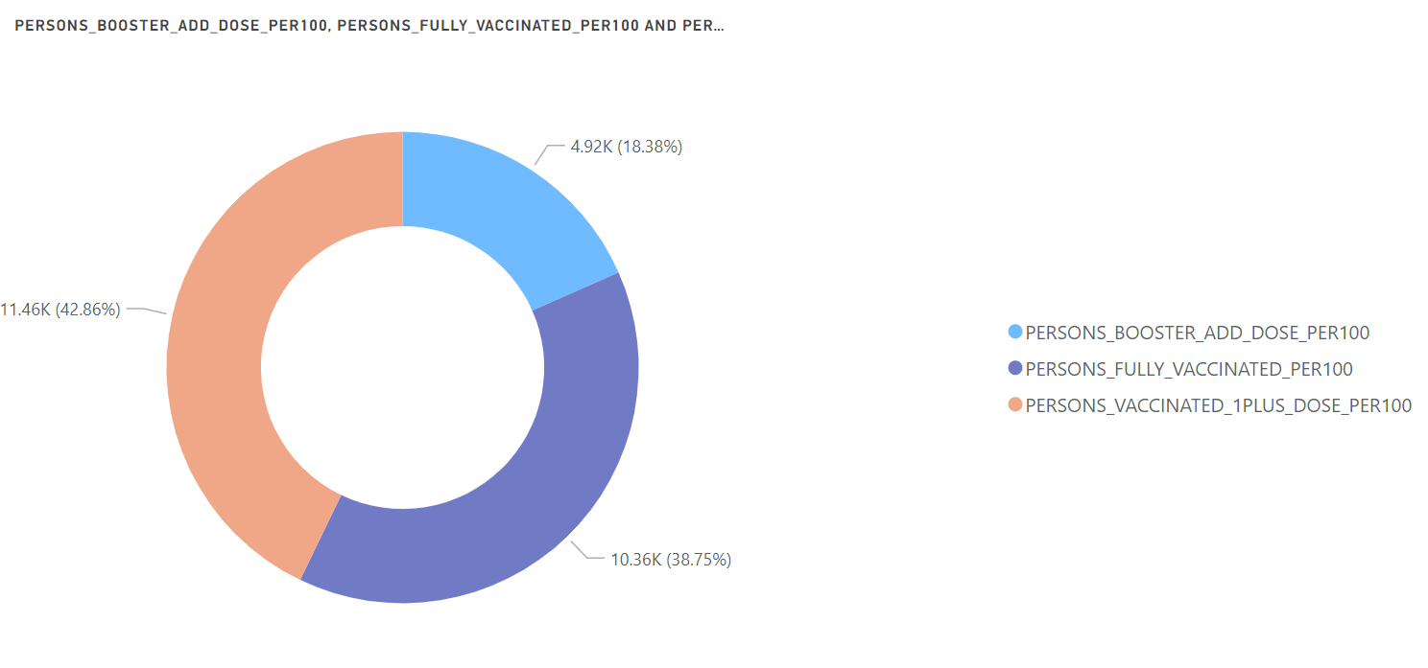
Vaccinated population per 100

Slide 11
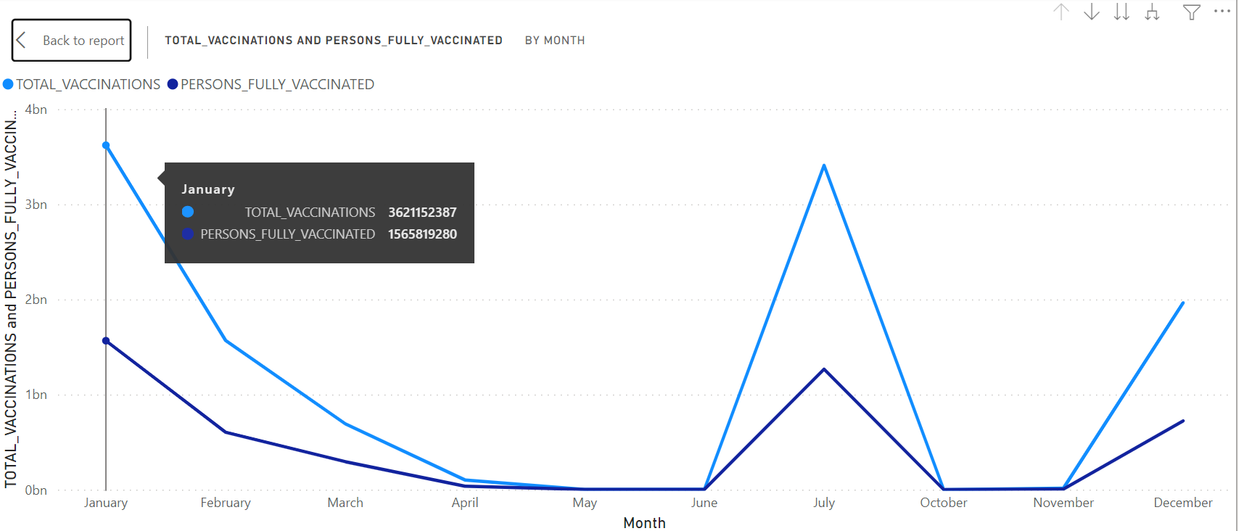
Total no. of vaccination Vs Fully vaccinated person in a Year

Slide 12
Conclusion
In this analysis we can clearly see that China and India are two leading countries in this covid-19 vaccination dataset. Most of the vaccinated population are from these two countries.
In booster dose column, we can clearly see that China and USA have more population which had their booster dose and fully vaccinated.

Slide 13
Thank you

